Slide 1
INTRO to DATA SCIENCE Lecture 2: Data science in python
Anthony Erlinger
DAT 20
3/17/15
Notes:
High level, but ‘zooming in’ from last lecture

Slide 2
- office hours - syllabus updates - Evaluation - Projects!
announcements
Notes:
Note: awk example
Git tutorial this wkd

Slide 3
Last lecture: - course logistics - what is data science? - the general workflow - basic git and command line - assignment: accessing the python environment
Recap
Notes:
Note: awk example
Git tutorial this wkd

Slide 4
I. review of git, github, and basic command line intermission iI. Getting started with the python data toolset
agenda
exercises: I. Creating your own github repository II. Forking the class github repository III. Markdown IV. Python intro

Slide 5
I. Working with Git (and github (and the basic command line))
Notes:
High level, but ‘zooming in’ from last lecture

Slide 6
Why learn version control?
Version control is useful when you write code, and data scientists write code
Enables teams to easily collaborate on the same codebase
Enables you to contribute to open source projects
Attractive skill for employment

Slide 7
What is Git?
Version control system that allows you to track files and file changes in a repository (“repo”)
Primarily used by software developers
Most widely used version control system
Alternatives: Mercurial, Subversion, CVS
Runs from the command line (usually)
Can be used alone or in a team
We’ll focus on the 10% of git commands that get used 95% of the time

Slide 8
What is GitHub?
A website, not a version control system
Allows you to put your Git repos online
Largest code host in the world
Alternative: Bitbucket
Benefits of GitHub:
Backup of files
Visual interface for navigating repos
Makes repo collaboration easy
GitHub is just “Dropbox for Git”
Note: Git does not require GitHub

Slide 9
The general workflow
Clone (download) an existing GitHub repo to your computer (first time only) git clone <repository url>
Make some file changes locally
Tell git to add changes: git add <local path or filename>
Save those changes locally by “committing” git commit –m ‘commit message’
Update your GitHub repo with those changes: git push origin master Suppose you come back to the code some time later…
6. Pull and merge updates that may have been committed by other collaborators git pull
Repeat 2-6

Slide 10
II. Contributing on GitHub

Slide 11
Forking a repo on GitHub
What is forking?
Copy a repo to your account (including history)
Does not stay in sync with the “upstream”
Do it! https://github.com/ga-students/DAT_20_NYC
Why fork?
You want to make modifications
You want to contribute to the upstream
Clone your fork: git clone <your URL>
Don’t clone inside your other local repo

Slide 12
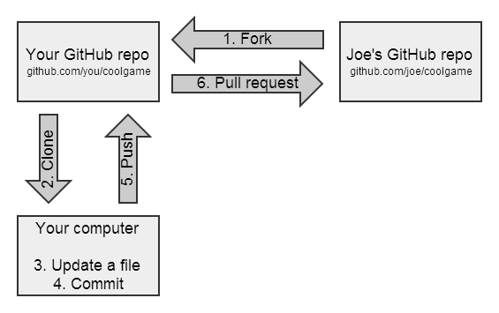
GitHub flow for contributing

Slide 13
Contribute to DAT20-students
Create a subdirectory in DAT20/students with your first name (lowercase): mkdir <name>
Change to that subdirectory: cd <name>
Create a file named “about.md”
Write something using Markdown (optional)
Using Git: add, commit, push
Create a pull request: “I request that you pull changes from my repo into your repo”

Slide 14
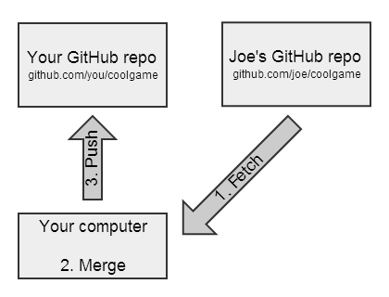
GitHub flow for syncing a fork

Slide 15
Sync your “DAT_20_NYC” fork
Files have been added to DAT_20_NYC
Add an “upstream” remote (one-time operation):
git remote add upstream <github url>
Check that it worked: git remote -v
Pull the changes from the upstream:
Like updating your local files from Dropbox
git pull upstream master
Pull = fetch + merge (basically)
Push the changes up to GitHub (optional):
git push origin master

Slide 16
Recipe for submitting homework
Navigate to DAT_20_NYC (locally)
git pull upstream master
Copy your homework file(s) to your folder
git add . or git add <filename>
git status
git commit -m “message”
git push origin master
Create GitHub pull request (from your fork)

Slide 17
BASIC MARKDOWN
Easy-to-read, easy-to-write markup language
Renders to multiple formats (HTML, PDF, etc.)
Many implementations (aka “flavors”)
Let’s edit README.md using GitHub! (Lectures/lesson02/exercises/Readme.md)
Common syntax:
## Header size 2
*italics* and **bold**
[link to GitHub](https://github.com)
* bullet
`inline code` and ```code blocks```
Valid HTML can also be embedded within Markdown
Notes:
Break after this!

Slide 18
III. Hello Python
Notes:
High level, but ‘zooming in’ from last lecture

Slide 19

Our toolset
Python (2.7.x)
Numpy: Performing raw calculations on data
Pandas: Querying, representing, and manipulating data
Matplotlib: Visualizing data
Statsmodels: Making statistical inferences from data
Scikit Learn: Learning from data and “model building”
IPython: Interacting with all of the above

Slide 20
Our toolset
Python (2.7.x)
Numpy: Performing raw calculations on data
Pandas: Querying, representing, and manipulating data
Matplotlib: Visualizing data
Statsmodels: Making statistical inferences from data
Scikit Learn: Learning from data and “model building”
IPython: Interacting with all of the above
Know your tools!!! No way to be productive otherwise.

Slide 21
Our toolset
Python (2.7.x)
Numpy: Performing raw calculations on data
Pandas: Querying, representing, and manipulating data
Matplotlib: Visualizing data
Statsmodels: Making statistical inferences from data
Scikit Learn: Learning from data and “model building”
IPython: Interacting with all of the above
Know your tools!!! No way to be productive otherwise.
*But also: Know where to find information when you get lost.
- Stack Overflow
- Bookmark Docs for each tool (Dash is also a VERY useful tool: http://kapeli.com/dash)
- “Google” stack traces and error messages.

Slide 22
The python data analysis Ecosystem
There are tons of tools, frameworks, and languages for data science:
R
Julia
Matlab
SAS
Mathematica
Stata
Maple
SPSS
Etc…
These tools aren’t necessarily mutually exclusive. We use Python because it’s simple, clean, popular, relatively easy to learn and well supported.

Slide 23
The python data analysis Ecosystem
Today
Python (2.7.x)
Numpy: Performing raw calculations on data
Pandas: Querying, representing, and manipulating data
Matplotlib: Visualizing data
Statsmodels: Making statistical inferences from data
Scikit Learn: Learning from data and “model building”
IPython: Interacting with all of the above
These will be used throughout the course:

Slide 24

The journey into Python
(Lectures/lesson02/exercises/00_intro_to_python.py)

Slide 25
Additional resources
See “Resources” folder in class repo
Git
Basic Git: https://try.github.io/levels/1/challenges/1
More advanced: http://pcottle.github.io/learnGitBranching/
Python
Quick tutorial:
https://github.com/adambard/learnxinyminutes-docs/blob/master/python.html.markdown
More Comprehensive:
http://learnpythonthehardway.org/
http://www.learnpython.org/
https://docs.python.org/2/tutorial/

Slide 26
The python data analysis Ecosystem
At Scale
Python
Numpy
Pandas
Matplotlib
Statsmodels
Scikit Learn
IPython
Map Reduce
Hive
Pig
HDFS
SQL
NoSQL

Slide 27
The python data analysis Ecosystem
At Scale
Python
Numpy
Pandas
Matplotlib
Statsmodels
Scikit Learn
IPython
Map Reduce
Hive
Pig
HDFS
SQL
NoSQL

Slide 28
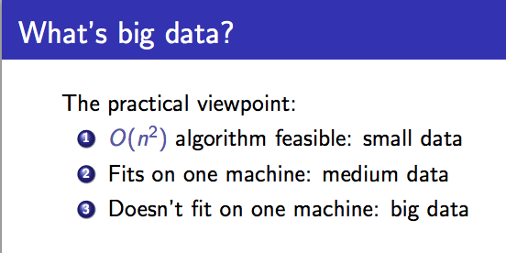
Buzzword break
source: http://people.cs.umass.edu/~mcgregor/stocworkshop/langford.pdf

Slide 29
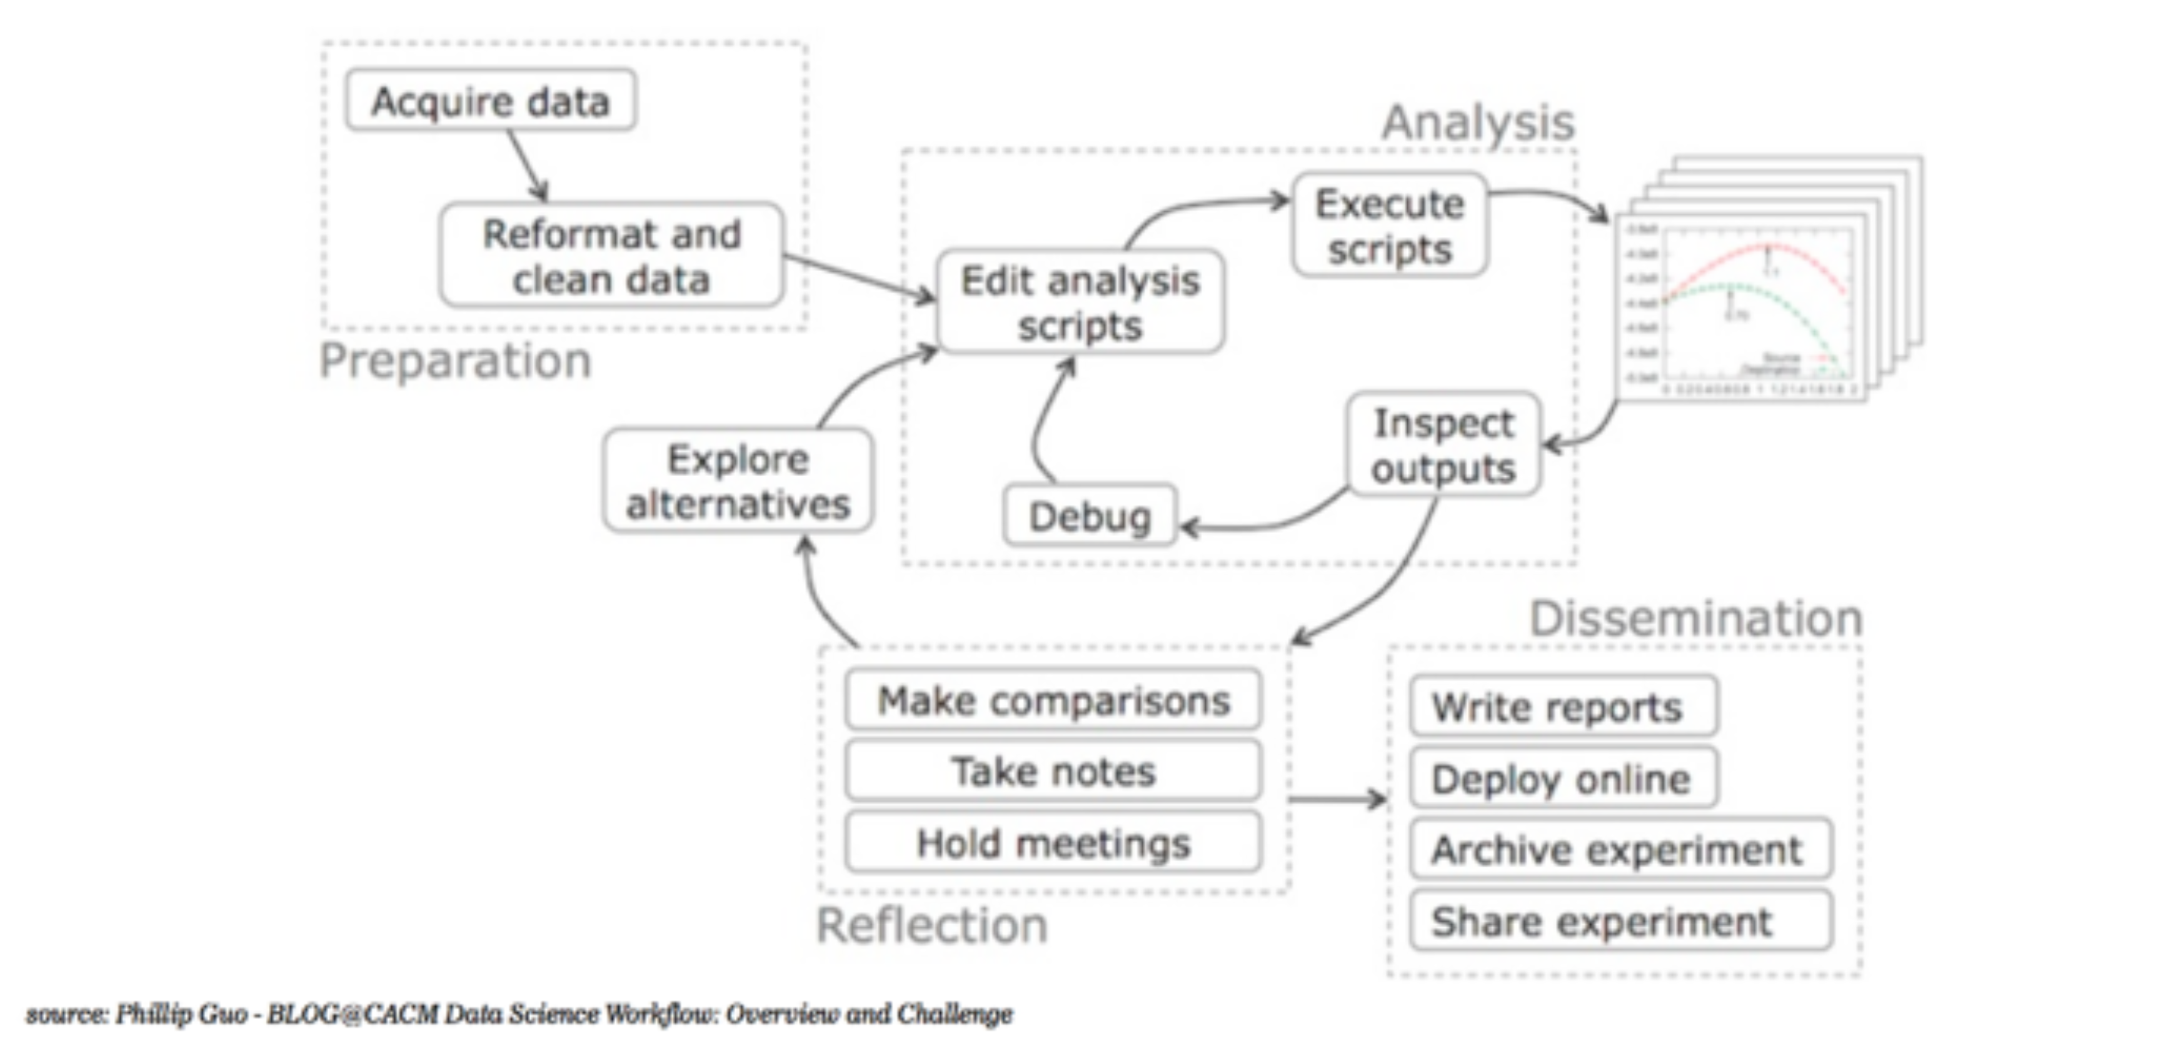
The workflow

Slide 30
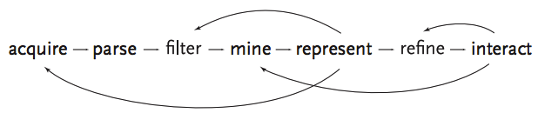

the data science workflow
NOTE
This diagram illustrates the iterative nature of problem solving
source: http://benfry.com/phd/dissertation-110323c.pdf
Notes:
Solving problems iteratively: not a straight line (eg, there’s really no correct order)
Start small & work your way out…Don’t try to do everything in a single step!
Q: why not?

Slide 31
DISCUSSION
INTRO TO DATA SCIENCE
Notes:
~20 min
Q: what do you think of the math we saw?
Q: how do you like using R?
Q: does anything seem mysterious?

